Slide 1
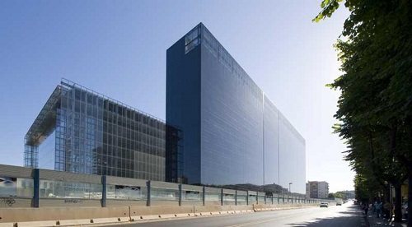
HILTON
Rome EUR La Lama

Slide 2
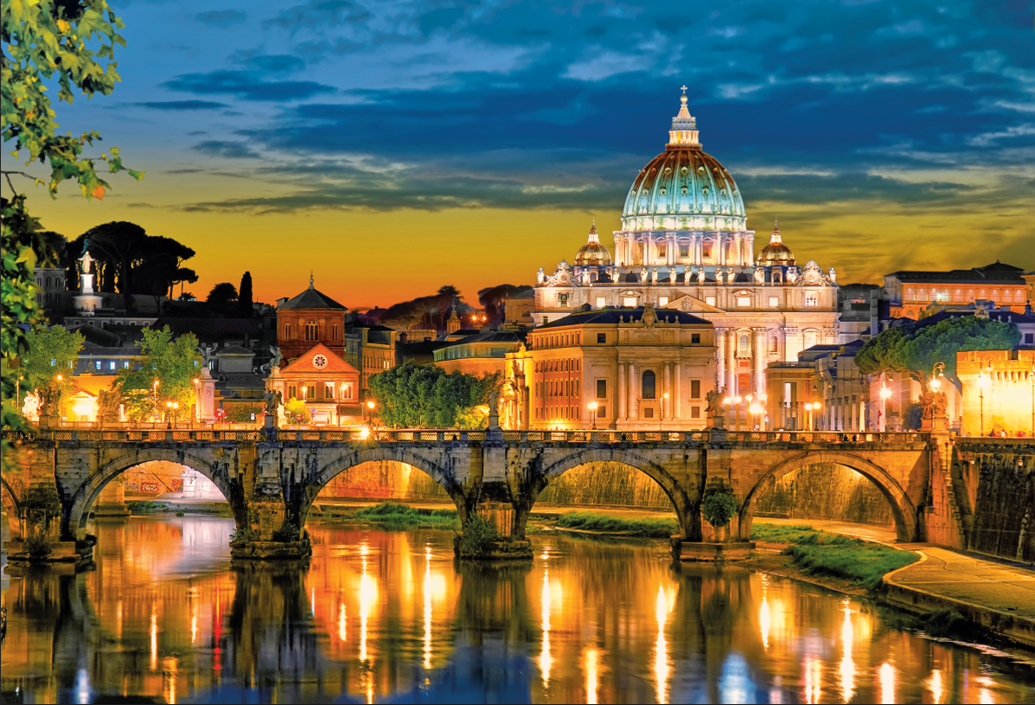

Rome
UNIQUE EMOTIONS BETWEEN ART AND HISTORY

Slide 3
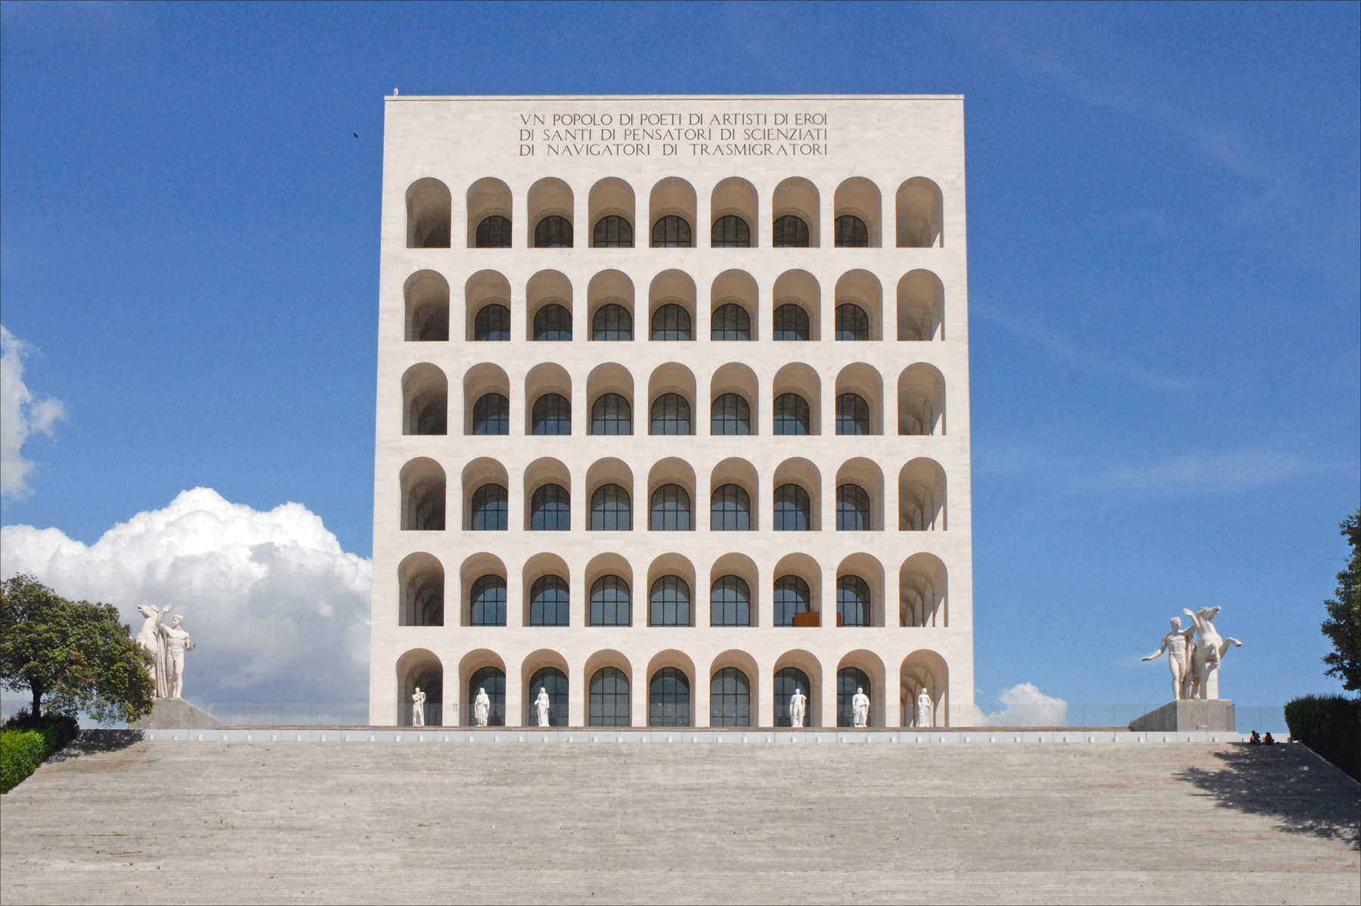
EUR
A CITY IN THE CITY
Rome Business District
Iconic monuments
Museums
Sport and Entertainment
Restaurants and Clubs
Shopping area and Malls

Slide 4
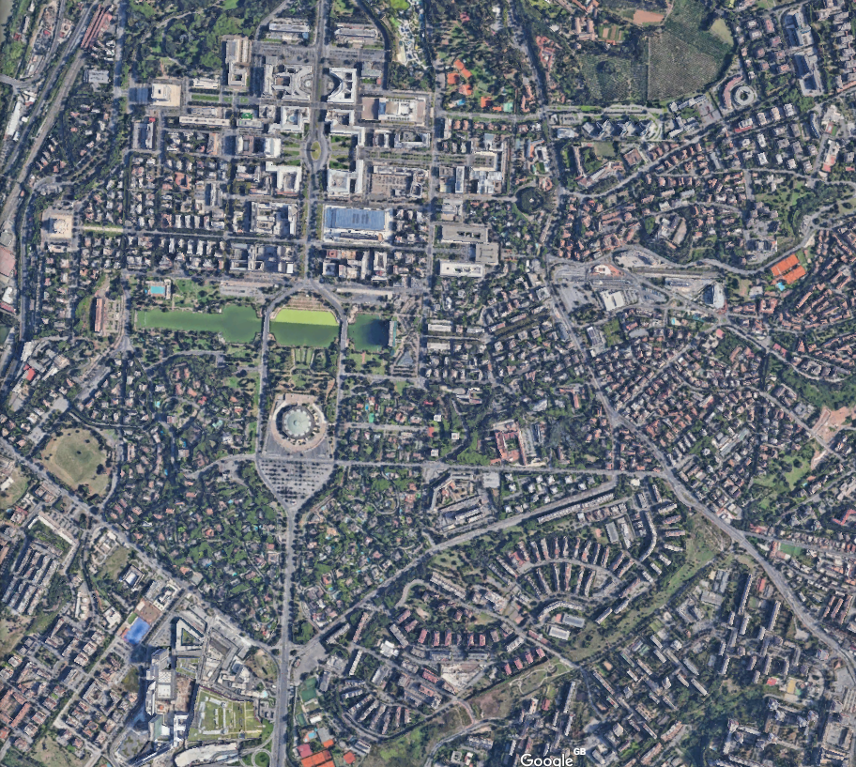


Hilton Rome Eur La Lama
Location
Palazzo della Civiltà Italiana
La Nuvola Congress Centre
Spazio 900
Salone delle Fontane
Shopping Mall
Eur Fermi Subway
Palalottomatica
Auditorium della Tecnica
Auditorium del Massimo
Access information
Termini Train Station- 15 min
Fiumicino Airport - 20 min
Ciampino Airport – 20 min
    Rome City Center – 15 min
Vatican City – St. Peter – 15 min
04/06/19

Slide 5
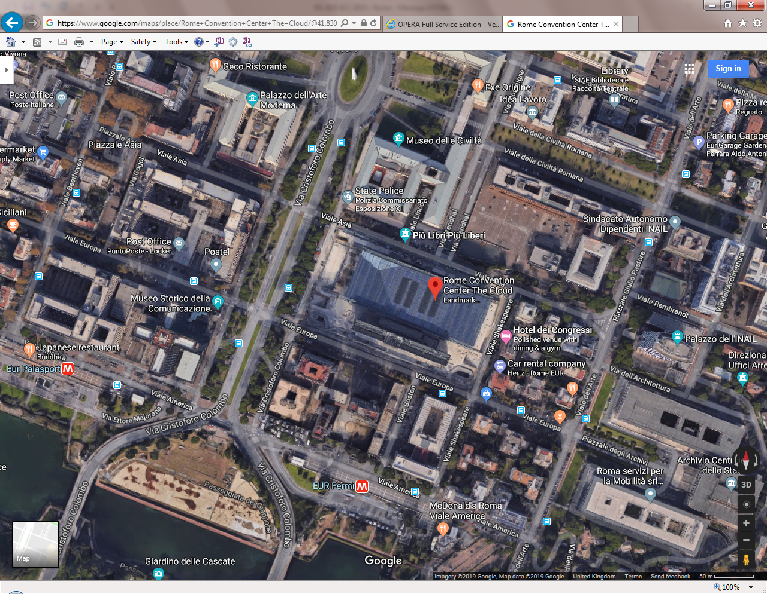
Hilton Rome EUR La Lama
Hilton
Rome EUR
La Lama

Slide 6
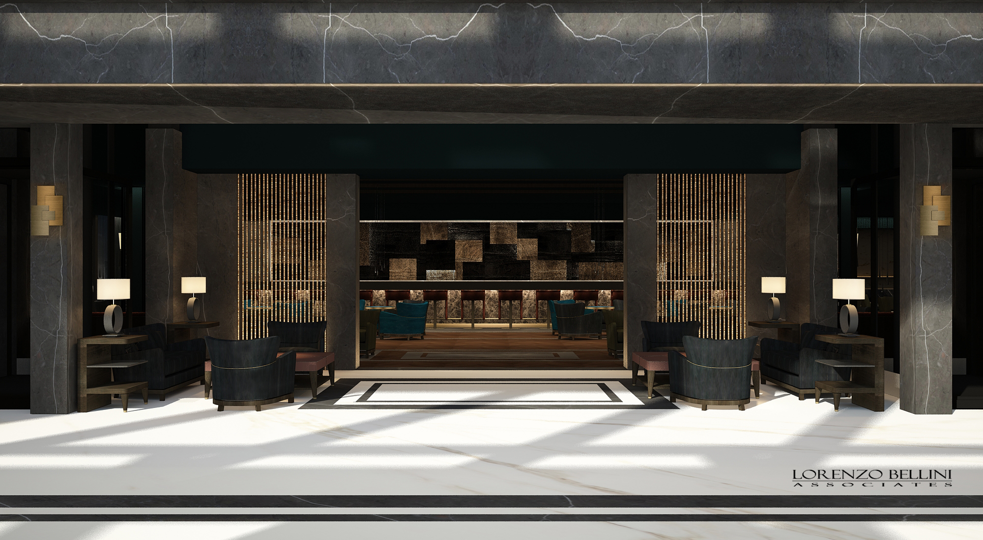
Shuttle bus
Wellness & Beauty
Connected to the airport
Relax or Workout?
Close to the sea
Hilton Rome EUR La Lama
TO AND FROM THE CENTRE OF ROME
DIRECTLY CONNECTED TO FCO AIRPORT BY AN OVERPASS WALKWAY
JUST A FEW MINUTES TO THE BEACH OF FIUMICINO
GYM AND INDOOR HEATED POOL
LARGE SPA IMMERSED IN A QUIET PARKLAND JUST BEHIND THE HOTEL

Slide 7
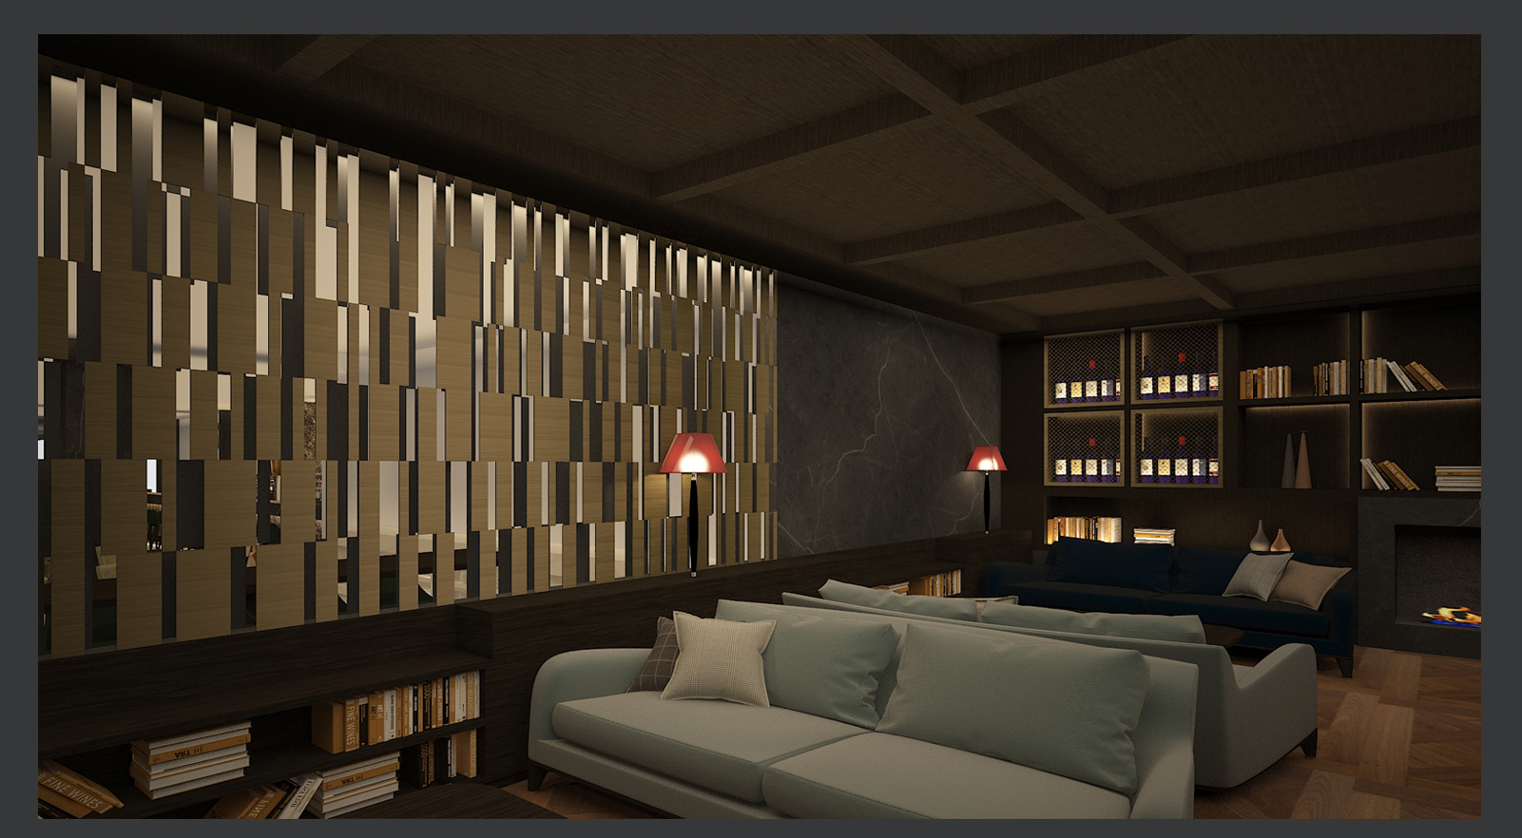
Shuttle bus
Wellness & Beauty
Connected to the airport
Relax or Workout?
Close to the sea
Hilton Rome EUR La Lama
TO AND FROM THE CENTRE OF ROME
DIRECTLY CONNECTED TO FCO AIRPORT BY AN OVERPASS WALKWAY
JUST A FEW MINUTES TO THE BEACH OF FIUMICINO
GYM AND INDOOR HEATED POOL
LARGE SPA IMMERSED IN A QUIET PARKLAND JUST BEHIND THE HOTEL
439 rooms and suites
Restaurant 250 seats
American cocktail bar 135 seats
Roof top restaurant 35 to 55 seats
Executive Lounge 110 sqm / 1185 sqft
Fitness centre 98 sqm / 1055 sqft
Meeting facilities: 7 Meeting rooms for a total of 845 sqm / 9095 sqft

Slide 8
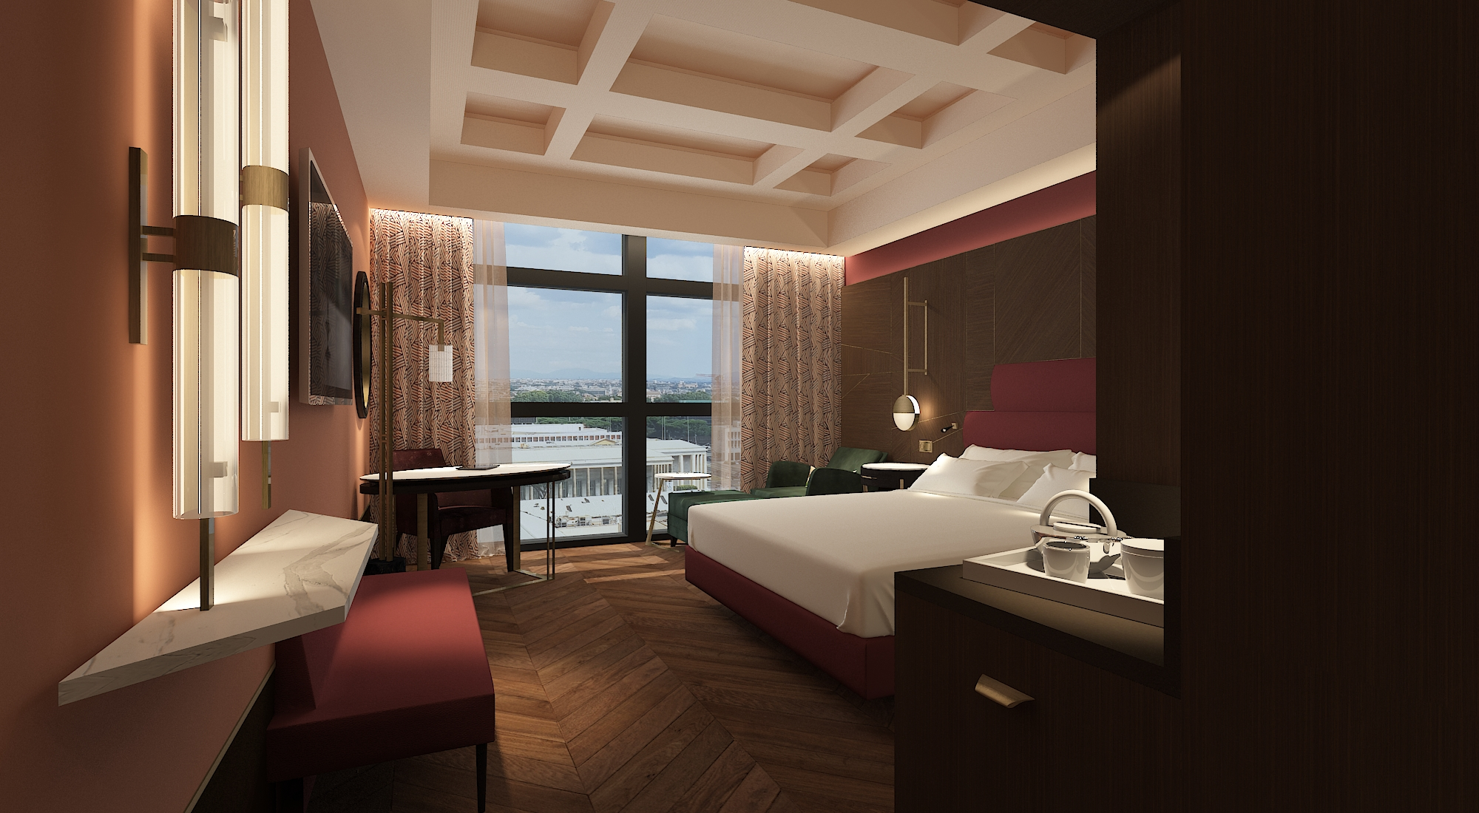
Wide and flexible congress centre
Perfect location
Team buildings and sports
Meet the light
Private dining
Hilton Rome EUR La Lama
INDOOR AND OUTDOOR AREAS TO THRIVE
DEDICATED MEETING FLOOR WITH NATURAL DAYLIGHT
LINKED TO THE AIRPORT AND ONLY 30 MIN FROM ROME CITY CENTRE
AND A COMMITTED STAFF TO SUPPORT YOUR EVENT
ENJOY A TYPICAL ITALIAN DINER IN THE PRIVATE DINING AREA
121 Hilton Guest rooms
199 Deluxe
38 Corner Rooms
52 Executive
22 Accessible
4 Junior Suites
2 Suites
1 Presidential
439 Total

Slide 9
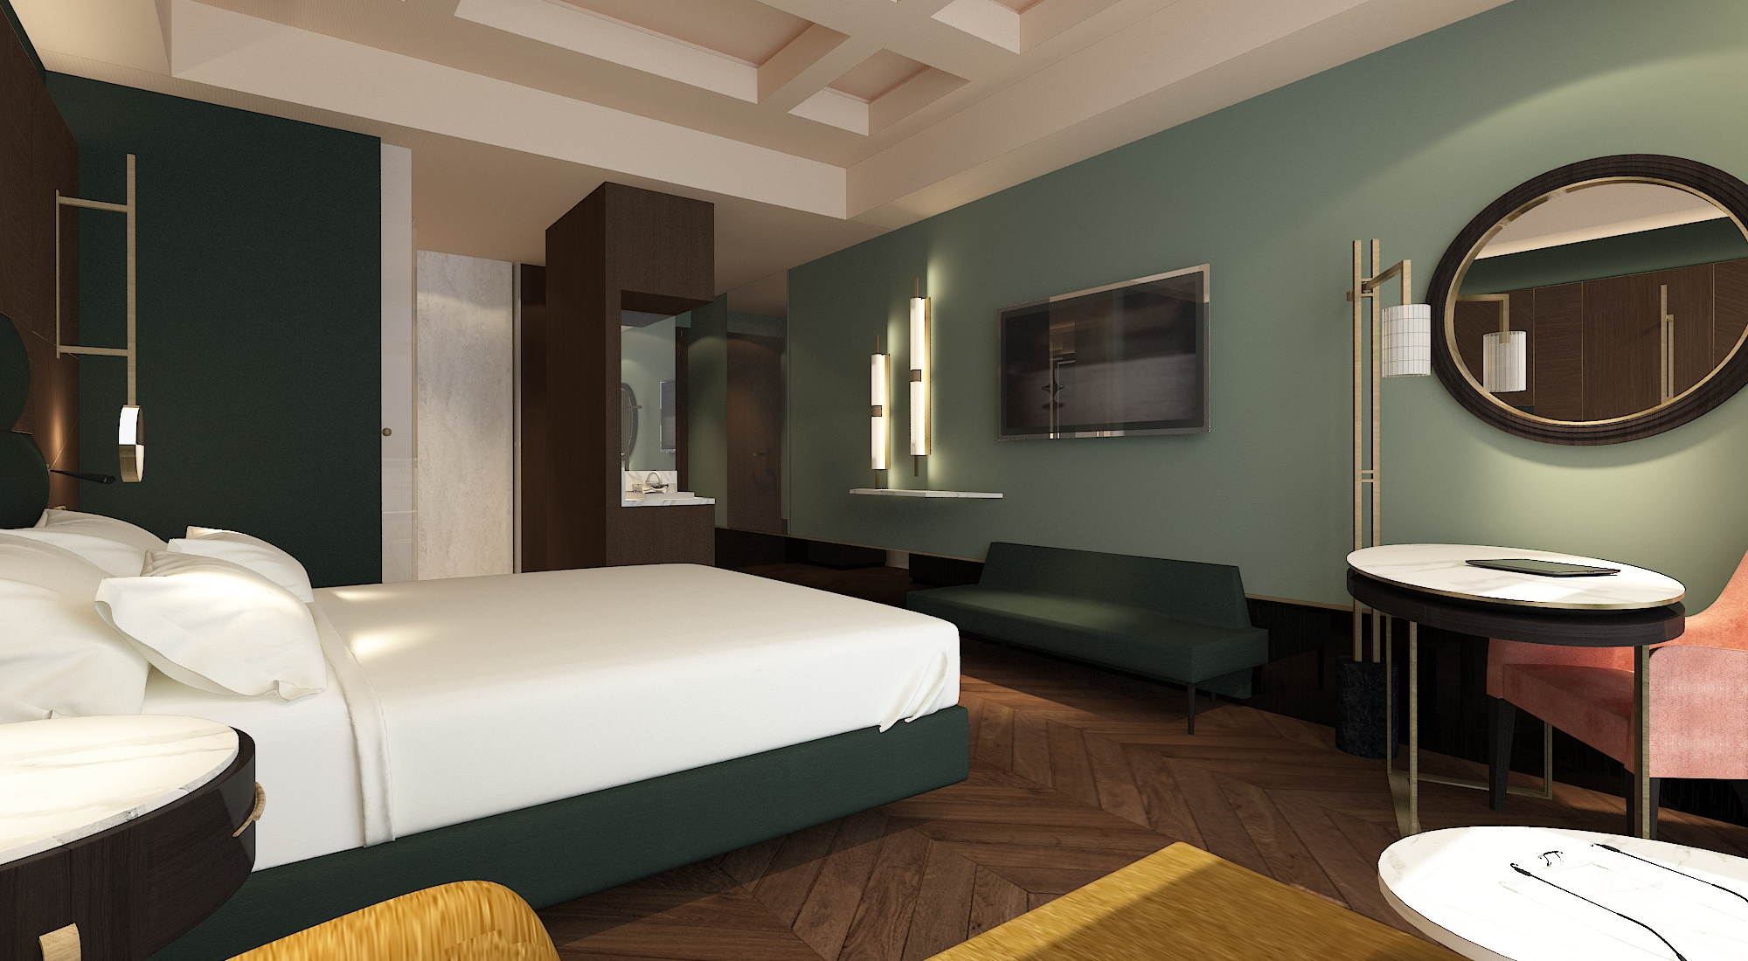
Wide and flexible congress centre
Perfect location
Team buildings and sports
Meet the light
Private dining
Hilton Rome EUR La Lama
INDOOR AND OUTDOOR AREAS TO THRIVE
DEDICATED MEETING FLOOR WITH NATURAL DAYLIGHT
LINKED TO THE AIRPORT AND ONLY 30 MIN FROM ROME CITY CENTRE
AND A COMMITTED STAFF TO SUPPORT YOUR EVENT
ENJOY A TYPICAL ITALIAN DINER IN THE PRIVATE DINING AREA

Slide 10
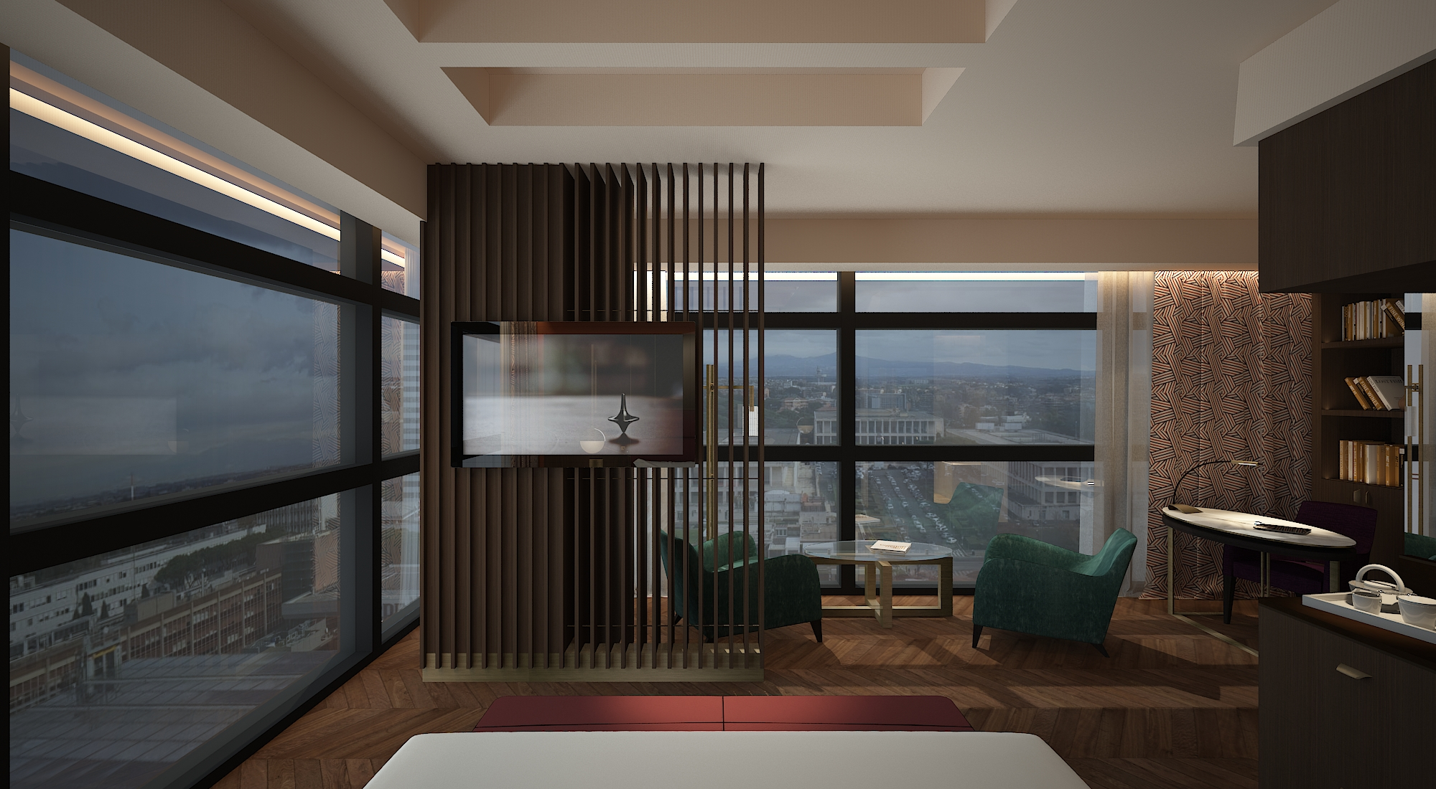
Wide and flexible congress centre
Perfect location
Team buildings and sports
Meet the light
Private dining
Hilton Rome EUR La Lama
INDOOR AND OUTDOOR AREAS TO THRIVE
DEDICATED MEETING FLOOR WITH NATURAL DAYLIGHT
LINKED TO THE AIRPORT AND ONLY 30 MIN FROM ROME CITY CENTRE
AND A COMMITTED STAFF TO SUPPORT YOUR EVENT
ENJOY A TYPICAL ITALIAN DINER IN THE PRIVATE DINING AREA

Slide 11
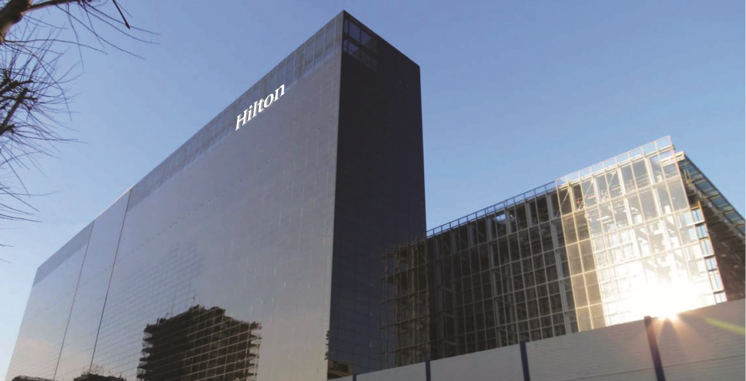
Hilton Rome Eur La Lama
THANK YOU!
04/06/19

